Slide 1
CSCI 3236 DFA Project
By: Michael McBratney, Elias Binchamo, Anthony Pierce, and Joseph Bello

Slide 2
Overall Project Description
For this project, we designed and built a DFA and used it to accept strings of a given language. Taken from a text file, the program takes the description of the DFA as a specified command line parameter.
The DFA file is accepted as a command line parameter.
At the end of execution, the program indicates whether the string is accepted.
Our program will accept multiple strings until the user types “exit”.

Slide 3
DFA File
{0,1}
{a,b,c,d,e}
a
{d,e}
{a,0}->b
{a,1}->c
{b,0}->c
{c,0}->d
{c,1}->e
{d,0}->d
{d,1}->d
{e,0}->e
{e,1}->e
Alphabet:
States:
Start state:
Accept states:
Transition Functions:
This is the DFA that our program will be using.

Slide 4
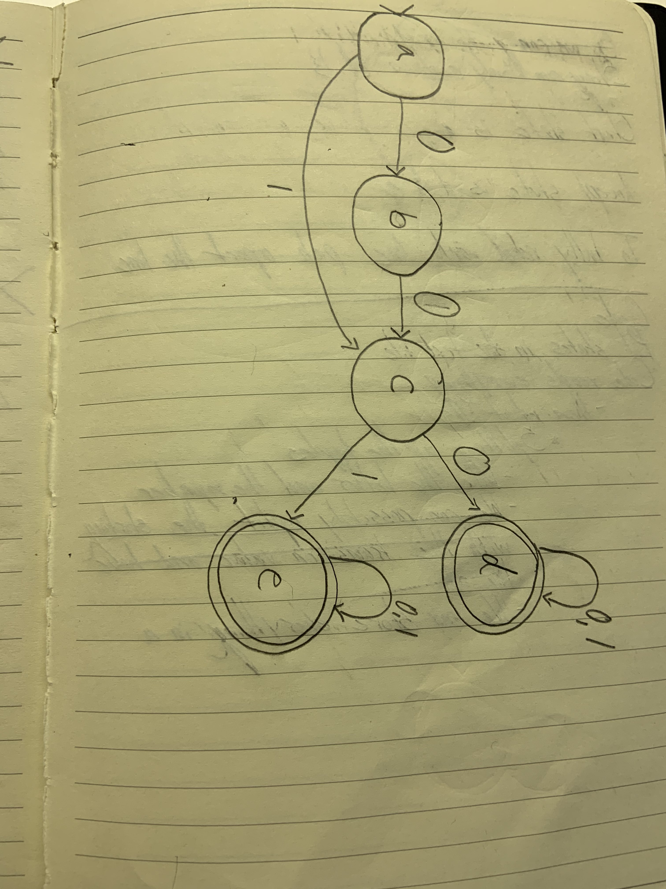

Slide 5
Transition Table:
State | Input | Output
a | 0 | b
a | 1 | c
b | 0 | c
c | 0 | d
c | 1 | e
d | 0 | d
d | 1 | d
e | 0 | e
e | 1 | e

Slide 6
(00U1)(0U1)+
The language accepted by our DFA is the following:

Slide 7
We will test the following strings to see whether or not they belong to the language that is accepted by our DFA:
Accept
101111
000111
Reject
010000

Slide 8
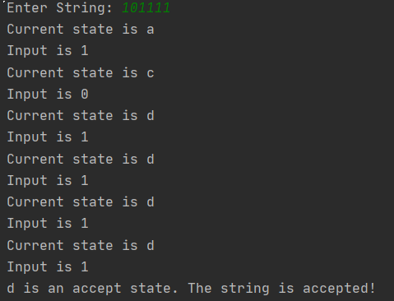

Slide 9
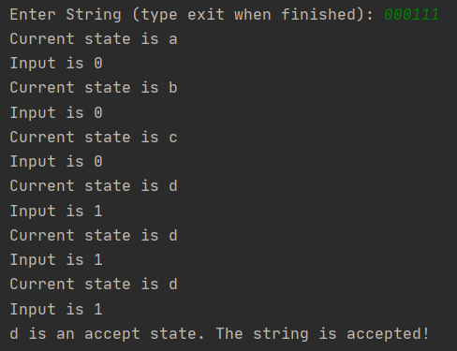

Slide 10
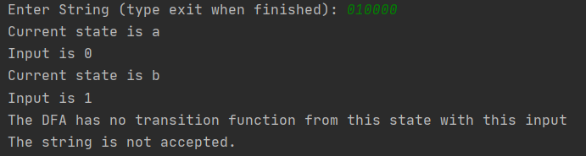

Slide 11


